Slide 1
Neio: TeX for the 21st century
Titouan Vervack
Promotor: Professor Marko van Dooren

Slide 2
What is it?
Markup language
Inspired by TeX and markdown

Slide 3
What’s wrong with Markdown
Not extensible
Too simple (no customisation)

Slide 4
What’s wrong with TeX
Steep initial learning curve
Allows redefenition of commands
Overly complex
Not static

Slide 5
What’s wrong with word
Corruptable fileformat
Not platform independent
Overkill for very simple documents
Not best suited for very complex documents

Slide 6
Goals
Easy to get started with
As powerful as TeX
As simple as markdown
Static typesystem

Slide 7
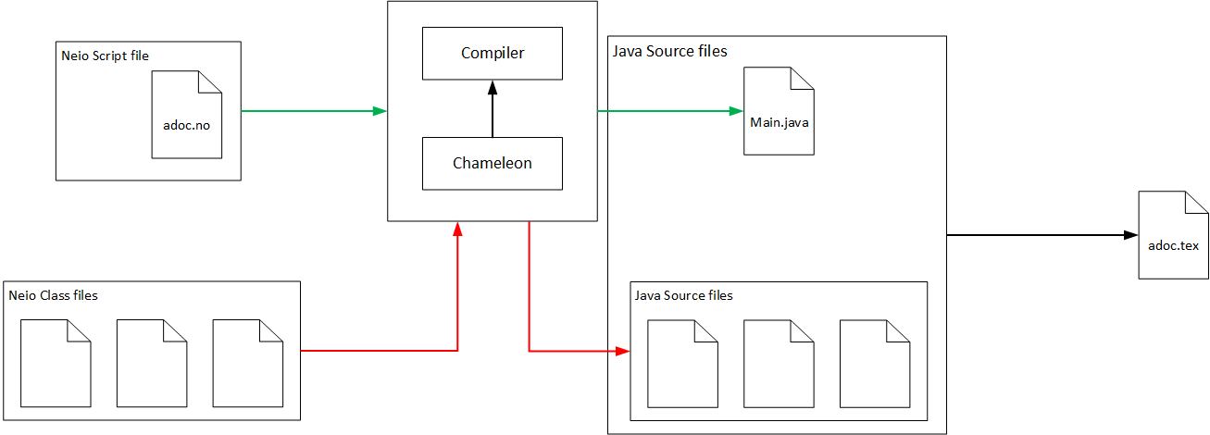
Compile flow
Neio class/script files
Compiler met Chameleon
Java files
Java main file
Via een neio file naar bv latex

Slide 8
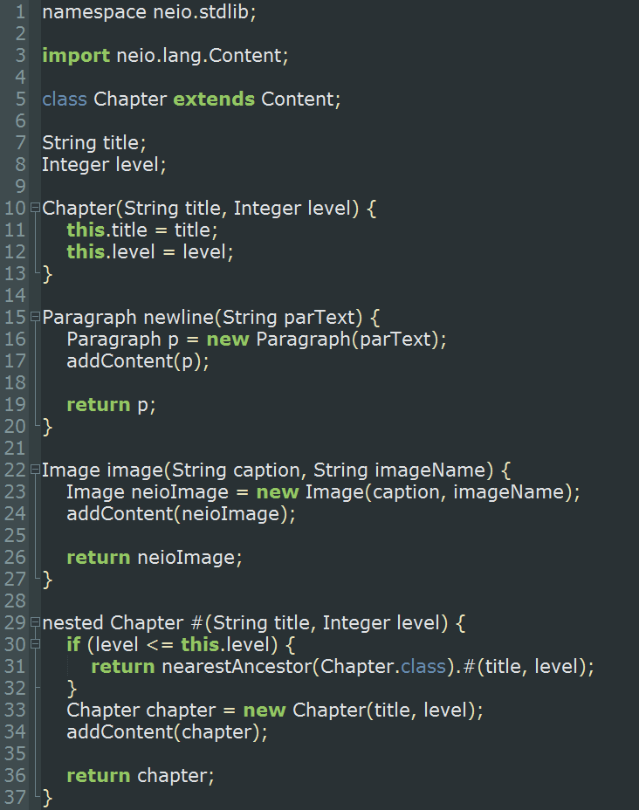
Neio class files
Javalike syntax
Adoptability
Easy translation

Slide 9
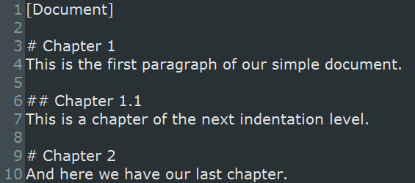
Neio script files
Markdownlike syntax
Adoptability
Easy to read/write
Non-corruptable

Slide 10
Why output in java?
Chameleon can output Java
Java is statically typed
Java is platform independent
Java semantic ≈ Neio semantic

Slide 11
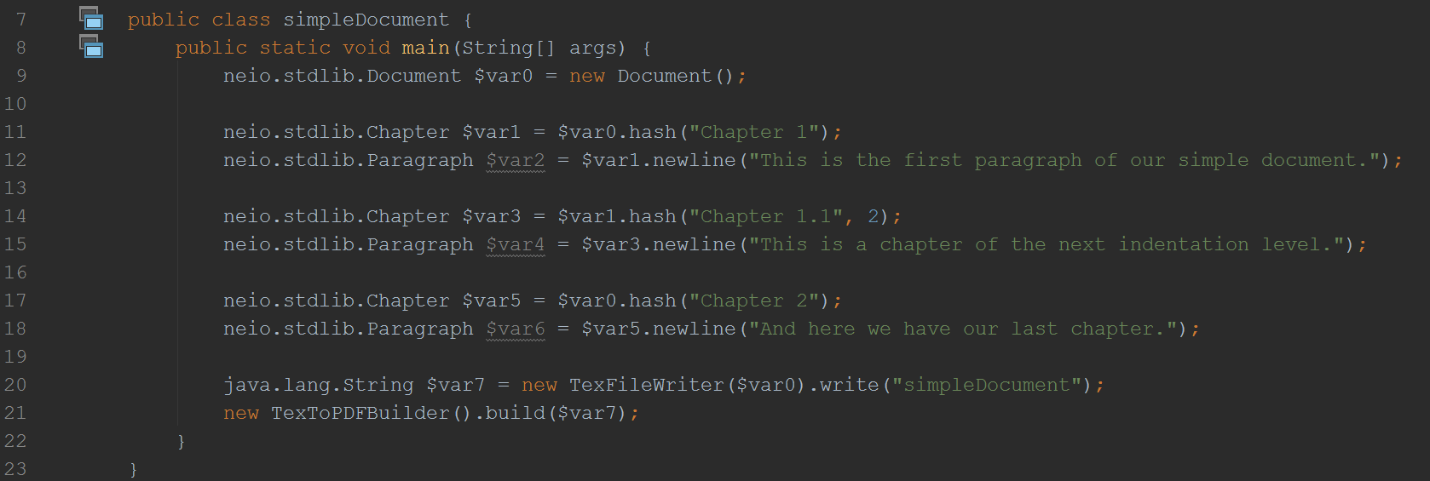
Building a document
Start out with documentclass
Everything is a methodcall

Slide 12
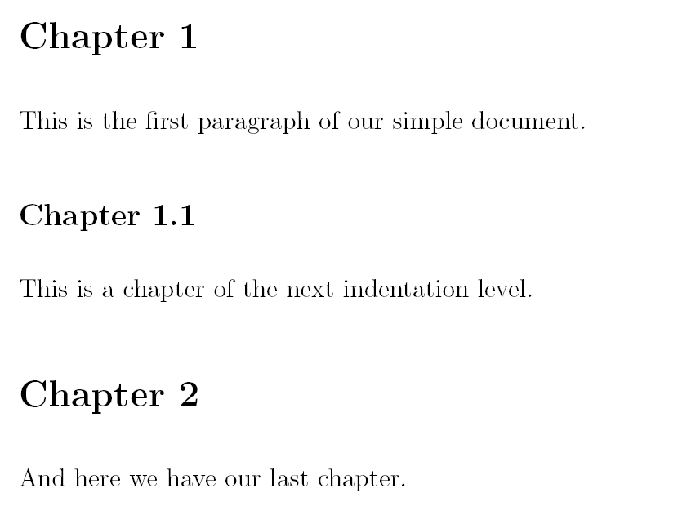
Building a document: result

Slide 13
Context types

Slide 14
Nested methods
Allow for nesting of the operator

Slide 15
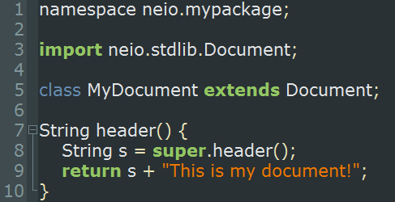
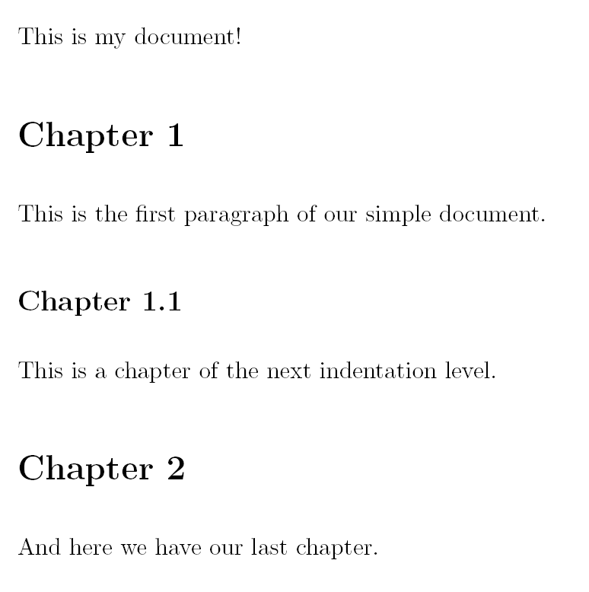
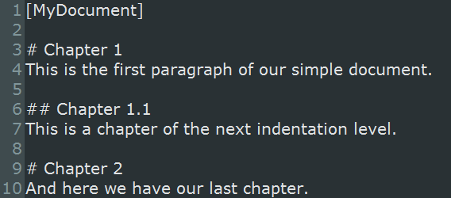
Customisability: inheritance

Slide 16
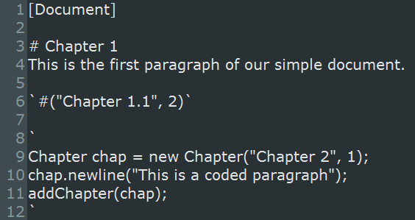
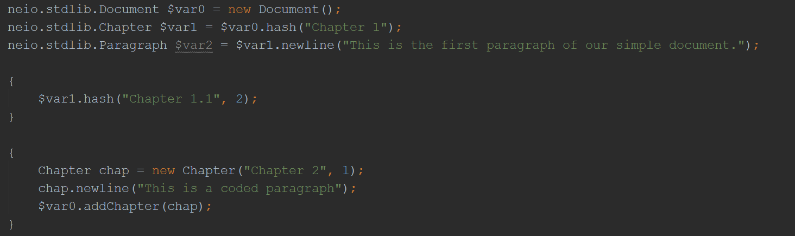
Customisability: executing code

Slide 17
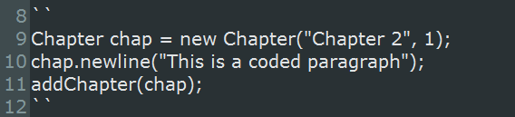
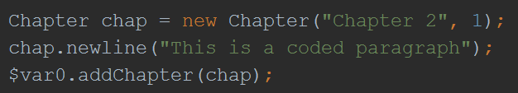
Customisability: executing code

Slide 18
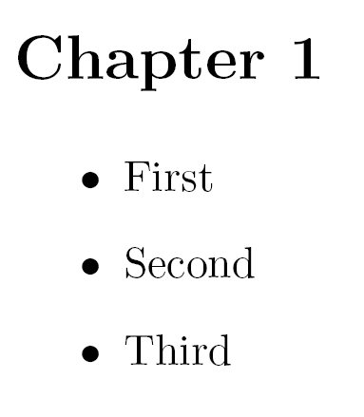
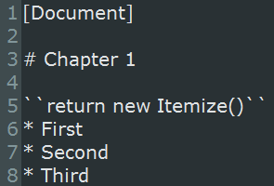
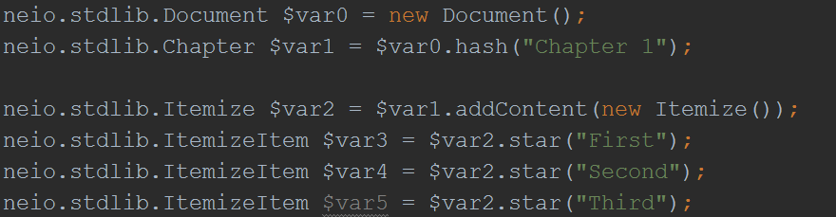
Add content through code

Slide 19
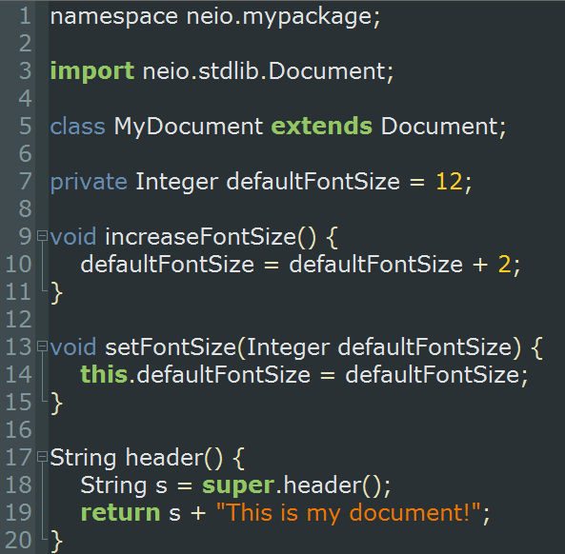
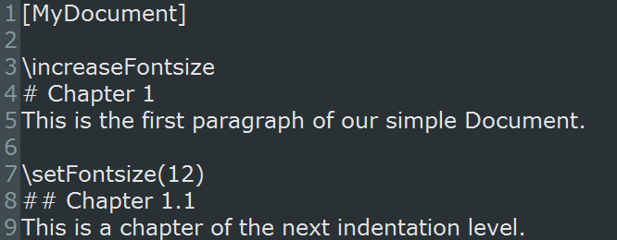
Customisability: custom commands

Slide 20
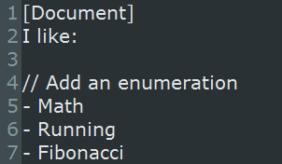
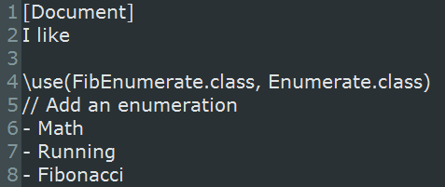
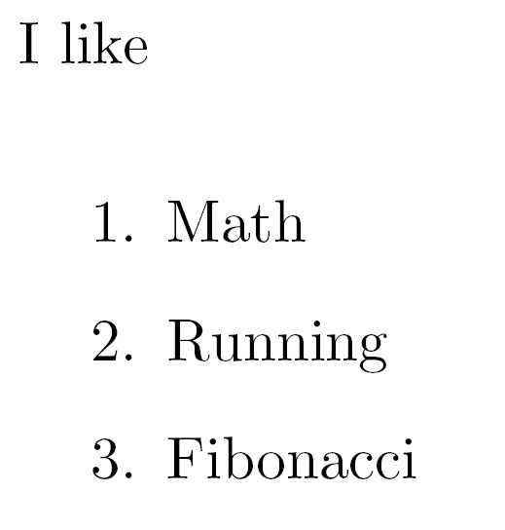
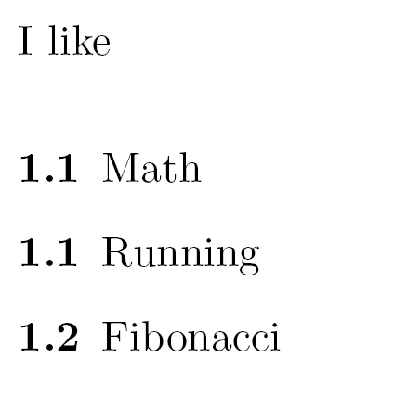
Customisability: use

Slide 21
Future work before hand in
Inclusions
Slideshows
Surround methodes
Further controles on static typing
Create more documentclassses (article, letter, book,…)

Slide 22
Future work
Native output to languages other than latex
Further implementation of commonly used latex packages
Compiler optimizations
Automatic double latex compile detection

